Slide 1

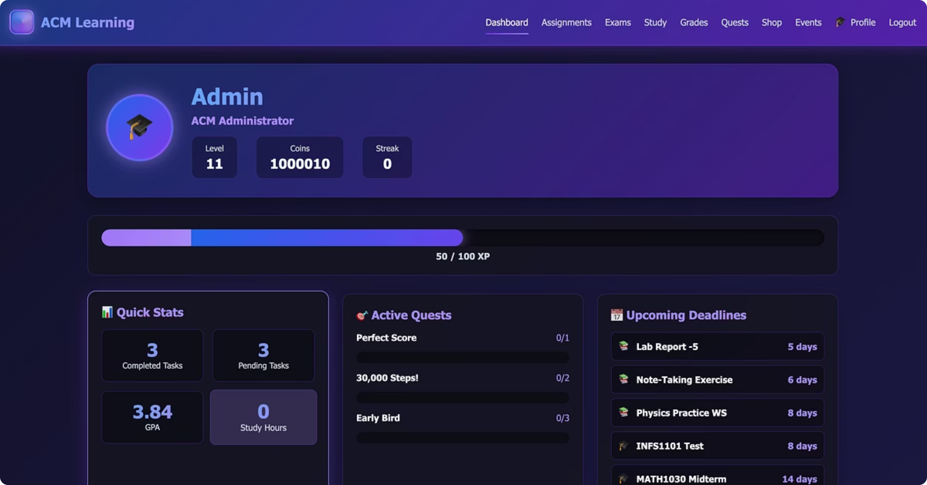
ACM Gamification Project
The ACM Gamification Project is an innovative web application designed to boost student engagement and productivity by applying gaming mechanics to academic life. Its core purpose is to transform traditionally mundane tasks into rewarding challenges, helping students effectively manage their school workload while earning incentives.
Team 1st Years: Syed Ahmed Khaderi & Manjunadha Karthikeya
ACM Gamification Hackathon

Slide 2












How Gamification Works in our ACM Website?
Assignments
Exams
Complete assignments to earn XP. Each assignment gives 50–200 XP depending on its priority.
Finish exams to get 50–300 XP based on how hard the exam is.
Leaderboards
See how you rank against other students and compare your XP and progress with classmates. This friendly competition motivates everyone to do better and is updated in real-time as students complete tasks.
Study Sessions
Earn 1 XP for every minute you study in a session.
Quests & Badges
Shop & Coins
Do quests to earn Badges. You can showcase your badges in your profile. Badges highlight your achievements to other students, with different types recognizing various accomplishments.
Finish tasks to get coins. You earn about 10–50 coins per completed task to spend in the shop.

Slide 3
How to Use the Platform
For Students: Getting Started
For Administrators: Managing the System
1
Registration
2
Dashboard
Content Management
Create your account with email and password.
See your progress, XP, coins, and assignment deadlines at a glance.
Create and manage Quests, shop items, and special Events.
3
Assignments
4
Study Sessions
User Oversight
Create and track your school assignments within the platform.
Use the integrated timer to log study time and earn XP.
Monitor student progress, XP accumulation, and overall platform engagement.
5
Quests
6
Shop
System Configuration
Complete challenges and special tasks for bonus rewards.
Spend earned coins on rewards and custom themes.
Configure rewards, set XP values for different activities, and manage the Shop inventory.
7
Profile
Customize your avatar and view all your earned achievements.

Slide 4





What is Gamification and Why It Works
Explaining Gamification in Simple Terms
Game-like Features
Motivation & Fun
Gamification means adding game-like features to non-game activities.
It uses points, badges, levels, and rewards to make boring tasks more fun.
Natural Desires
Play & Win
People naturally like to compete, achieve goals, and get rewards.
It taps into our basic desire to play and win.
Why It Works for Students
1
2
3
Engaging Study
Instant Rewards
Friendly Competition
Makes studying feel less like work and more like a game.
Students get instant rewards for completing tasks.
Creates friendly competition between classmates.
4
5
Clear Progress
Sustained Motivation
Helps students see their progress clearly.
Motivates students to keep going when things get hard.
Real Examples from Our Website
XP for Assignments
Coins for Tasks
Level Up
Get XP points for finishing assignments (50-200 XP).
Earn coins for every completed task (10-50 coins).
Level up as you gain more XP.
Collect Badges
Virtual Shop
Collect badges for special achievements.
Buy rewards in the virtual shop.

